Slide 1
Modern Data Protection
Veeam Product Portfolio
Moritz Höfer, System Engineer

Slide 2
What we do!

Slide 3
A vicious cycle
24x7 operations
Shrinking backup window
Data explosion
30-50% annual growth
Increasing recovery demands
Little tolerance for data loss
Source: Controlling Storage Amid High Growth; February 3, 2010; Forrester Research, Inc.
Notes:
Additional source: 2008 Trends in Backup and Data Protection; April 2, 2008; Forrester Research, Inc.

Slide 4
The solution
Veeam Management Suite
Veeam ONE + Veeam Backup & Replication
Virtualization Management
Veeam ONE
Veeam Backup & Replication
Virtualization-Powered
Data Protection
Veeam Management Pack (MP)
Veeam Essentials
Veeam ONE + Veeam Backup & Replication in an SMB bundle

Slide 5
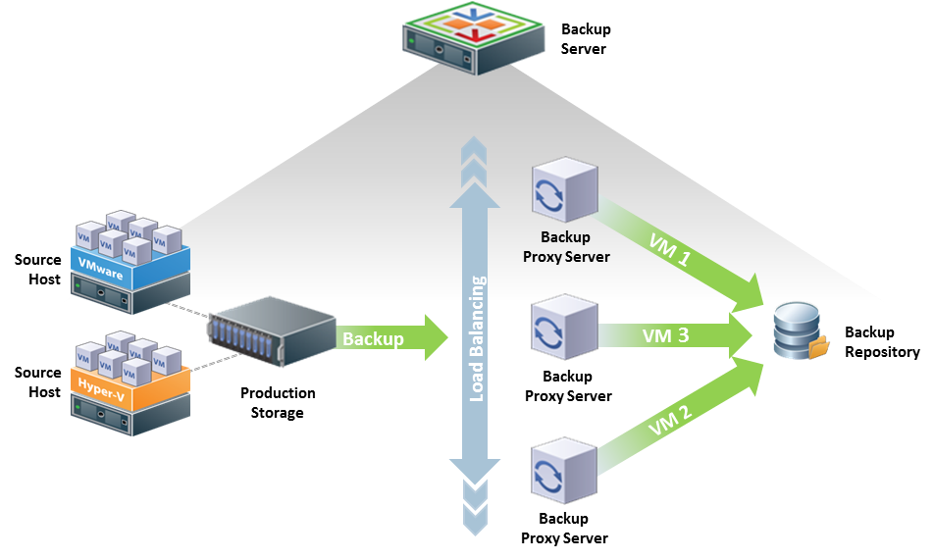
Veeam Backup and Replication

Slide 6
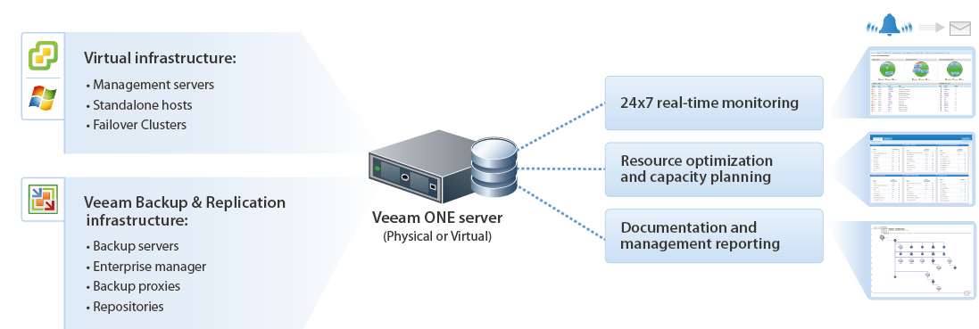
Veeam ONE

Slide 7
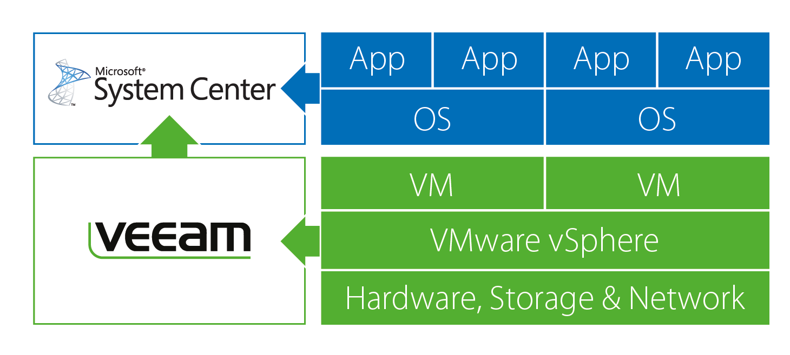
What is Veeam MP?
Veeam Management Pack extends deep VMware monitoring, management, forecasting and planning to Microsoft System Center, providing a unified view of physical and virtual infrastructures and applications from one console, so you can solve problems fast!
Veeam Management Pack extends deep VMware monitoring, management, forecasting and planning to Microsoft System Center, providing a unified view of physical and virtual infrastructures and applications from one console, so you can solve problems fast!
Veeam Management Pack extends deep VMware monitoring, management, forecasting and planning to Microsoft System Center, providing a unified view of physical and virtual infrastructures and applications from one console, so you can solve problems fast!
Veeam Management Pack extends deep VMware monitoring, management, forecasting and planning to Microsoft System Center, providing a unified view of physical and virtual infrastructures and applications from one console, so you can solve problems fast!
Visibility from app to metal!
Notes:
SPEAKER NOTES:
The Veeam Management Pack is a Microsoft System Center Management Pack specifically designed for everybody that has System Center Operations Manager and Vmware running in it’s environment. It provides you with <click> deep Vmware monitoring, forecasting and planning specifically for your virtual environment. It will leverage your investment in System Center AND provide you <click> with a unified view of both your physical and virtual infrastructure from one console. This allows you to <click> solve your problems fast!
<click>
With the Veeam Management pack and Microsoft System Center you will get the visibility you need from the application to the bare metal
In the next hour we are going to show you how you can achieve this by using the Veeam Management Pack version 6

Slide 8
Physical backups don’t work
Fewer spare resources available for backup
Doesn’t backup the entire VM
Requires agents in every VM
A
A
A
Hypervisor Host

Slide 9
Legacy tools still require agents
Costly:
to license, deploy and maintain agents in every VM
Complex:
to troubleshoot and resolve conflicts on VMs
Risky:
doesn’t fully protect new or powered-off VMs
A
A
A
Hypervisor Host

Slide 10
Veeam Backup & Replication Instant Recovery
VM
VM
VM
VM
VM
VM
Quick Migration
VM
VM
VM
VM
VM
VM
Production Datastore
NFS
Backup to Disk Datastore
Backup Compressed & Deduplicated

Slide 11
Veeam Backup & Replication Item Recovery
File/Folder Restore: direct from compressed and deduplicated Backup file
VM
Veeam Explorer for Exchange ^{neu}: direct from compressed and deduplicated backup file (needs Exchange 2010)
Virtual Lab
VM
VM
VM
VM
VM
VM
Backup to Disk Datastore
Universal Application-Item Recovery: isolated environement (Virtual Lab) configured and managed by Veeam use Instant VM Recovery technology
Snapshot
Veeam Explorer for SAN Snapshots ^{neu}: Veeam Restores of SAN Snapshots Support for HP Lefthand/VSA (3Par)

Slide 12
Widespread adoption
8M VMs protected
58K customers
55,000
415,000
1,300,000
8,000,000
1,200
5,700
58,000
3,400,000
32,000
15,000
2008
2009
2010
2011
2012
2008
2009
2010
2011
2012

Slide 13
Veeam innovation
v1
v3
v5
6.1
2-in-1: backup and replication
Instant File-Level Recovery
Built-in deduplication
Synthetic full backups
Replica rollback
Centralized management
Support for vStorage APIs
Support for CBT
Support for thin-provisioned disks
Near-CDP
Replication to ESXi
vPower
SureBackup
Instant VM Recovery
U-AIR
On-Demand Sandbox
Instant indexing
VeeamZIP
vPower for Hyper-V
Veeam Backup Free Edition
Q3 08
Q4 09
Q4 11
Q4 12
Q1 08
Q1 09
Q4 10
Q2 12
ESXi support with VCB
Fastest VCB performance
Advanced VSS support
Instant File-Level Recovery for Linux
ESXi support without VCB
Enterprise scalability
Advanced replication
Hyper-V support
1-Click File Restore
Veeam Explorer for Microsoft Exchange
Veeam Explorer for SAN Snapshots
New hypervisor support: vSphere 5.1 and Windows Server 2012 Hyper-V
v2
v4
6.0
6.5

Slide 14
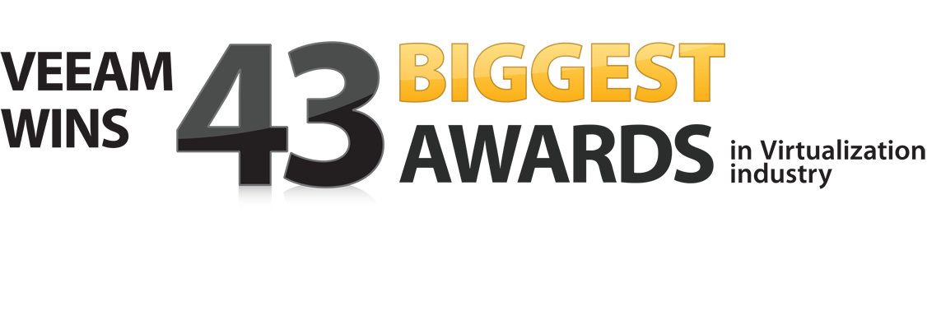
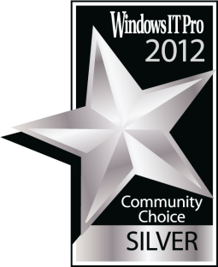
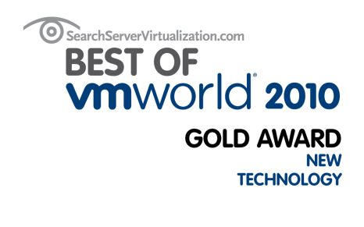
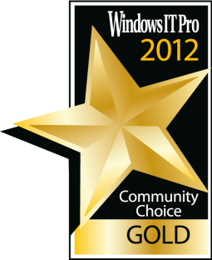
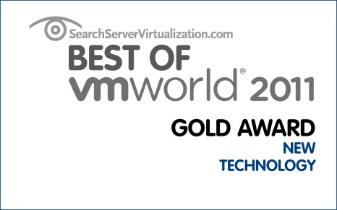
Numerous awards

Slide 15
Thank you

