Slide 1
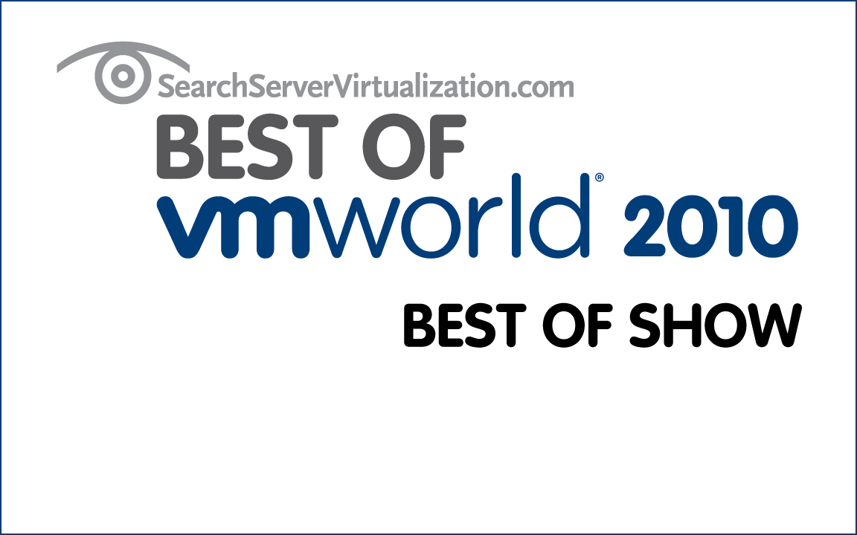
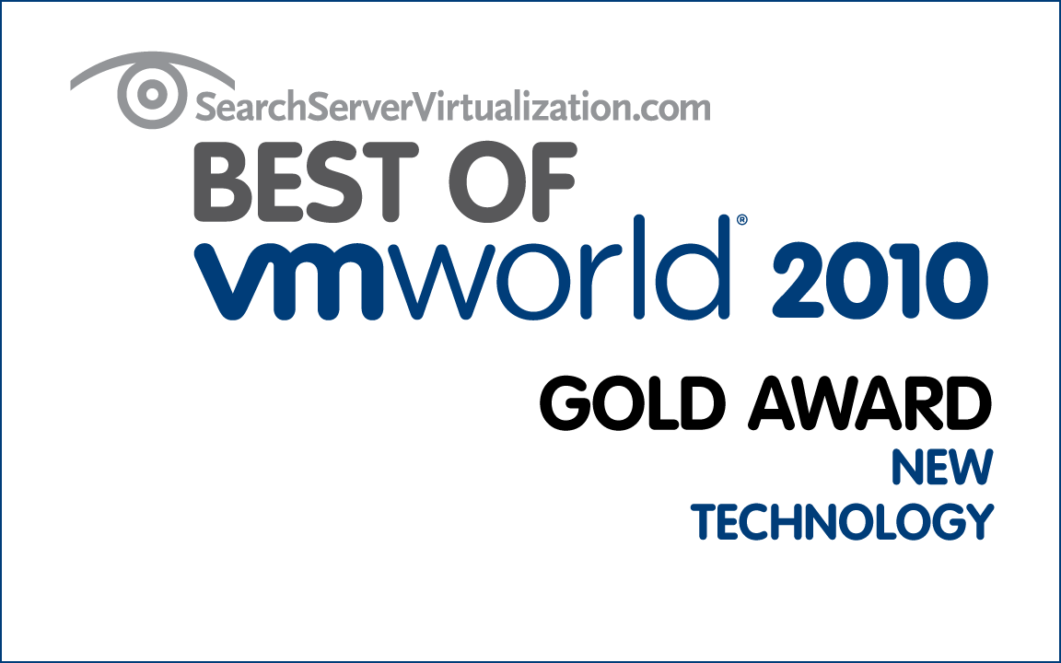

Five Battle-Tested Practices to Avoid Data Loss
Greg Shields, MVP, vExpert
Notes:
20110215

Slide 2
Administrative points on this webinar
Questions
  Can use the virtual Q&A panel.
  This webinar is recorded and available for replay after a few days.
  At the end of the webinar, we can raise virtual hand for dialog questions.
  Stick around until the end of the webinar!
    Winners will receive a choice of books!
Overview of Veeam

Slide 3





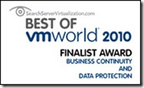


About Veeam
Veeam Software develops innovative products
for virtual infrastructure management
and data protection.
Reduce costs, mitigate risk, and fully realize the promise of virtualization with Veeam.

Slide 4
Five Battle-Tested Practices to Avoid Data Loss
Greg Shields, MVP, vExpert
Notes:
20110215

Slide 5
Notes from the Field
The data protection activity is one that’s indifferent of company size.
  Most companies don’t believe this.
  Some vendors don’t believe it either.
At the end of the day, it is ensuring data recoverability that’s the most critical activity.
  Recognize that today’s evolving technologies no longer mandate that it be the only activity.
  Seek more out of your backup solution.
Stop calling it “backups”.

Slide 6
Battle-Tested Practice #1
Define an RTO and RPO,
even if you don’t call it that.

Slide 7
Battle-Tested Practice #1
Define an RTO and RPO,
even if you don’t call it that.
Recovery Time Objective =
  “How long will you allow services to be unavailable?”
Recovery Point Objective =
  “How much data are you willing to lose should something happen?”

Slide 8
Battle-Tested Practice #1
Define an RTO and RPO,
even if you don’t call it that.
Recovery Time Objective =
  “How long will you allow services to be unavailable?”
Recovery Point Objective =
  “How much data are you willing to lose should something happen?”
Big companies call these by their formal names.
Smart small companies don’t.
The failing companies don’t even know what they mean.
Why?
Because the answer to these questions drives
every other decision in data protection.

Slide 9
Battle-Tested Practice #1
Define an RTO and RPO,
even if you don’t call it that.
Recovery Time Objective =
  “How long will you allow services to be unavailable?”
Recovery Point Objective =
  “How much data are you willing to lose should something happen?”
Big companies call these by their formal names.
Smart small companies don’t.
Failing companies don’t even know what they mean.

Slide 10
Battle-Tested Practice #2
Evolve past tape backups,
but perhaps don’t eliminate them.

Slide 11
Battle-Tested Practice #2
Evolve past tape backups,
but perhaps don’t eliminate them.

Slide 12
Battle-Tested Practice #2
Evolve past tape backups,
but perhaps don’t eliminate them.
Server to disk to tape.
Server to disk to cloud.
Server to disk to tape-and-cloud.

Slide 13
Battle-Tested Practice #2
Evolve past tape backups,
but perhaps don’t eliminate them.
Server to disk to tape.
Server to disk to cloud.
Server to disk to tape-and-cloud.
You’ve already invested in your tape infrastructure.
  There is little reason to eliminate it.
  Smarter idea: Augment it.

Slide 14
Battle-Tested Practice #3
For goodness’ sake, mind VSS.

Slide 15
Battle-Tested Practice #3
For goodness’ sake, mind VSS.

Slide 16
Battle-Tested Practice #3
For goodness’ sake, mind VSS.
The role of VSS in backups too often gets forgotten.
  Failures in VSS’ architecture are often the source of failed backups.

Slide 17
Battle-Tested Practice #3
For goodness’ sake, mind VSS.
The role of VSS in backups too often gets forgotten.
  Failures in VSS’ architecture are often the source of failed backups.
Many times, VSS failures are not actually VSS failures.
  VSS Writer failures or failed registration
  Poorly coded VSS Writers
  VMware Tools / Hyper-V Integration Services
  Your backup software

Slide 18
Battle-Tested Practice #3
For goodness’ sake, mind VSS.
The role of VSS in backups too often gets forgotten.
  Failures in VSS’ architecture are often the source of failed backups.
Many times, VSS failures are not actually VSS failures.
  VSS Writer failures or failed registration
  Poorly coded VSS Writers
  VMware Tools / Hyper-V Integration Services
  Your backup software
Virtualization complicates VSS’ role.

Slide 19
Battle-Tested Practice #3
For goodness’ sake, mind VSS. (VMware Edition)

Slide 20
Battle-Tested Practice #3
For goodness’ sake, mind VSS. (Hyper-V Edition)

Slide 21
Battle-Tested Procedure #4
Shift off tape restores,
but also shift off the tape restore mentality.

Slide 22
Battle-Tested Procedure #4
Shift off tape restores,
but also shift off the tape restore mentality.
Or, in other words:
“A disk is a disk is a disk is a disk is a disk.”

Slide 23
Battle-Tested Procedure #4
Shift off tape restores,
but also shift off the tape restore mentality.
Or, in other words:
“A disk is a disk is a disk is a disk is a disk.”
VM disk files…are just files on disk.
  When VMs are powered down, their disk files are little different than a Word document or an Excel spreadsheet.
  Dormant, they’re merely files consuming space.
  They’re also just “files consuming space” on your backup disks.

Slide 24
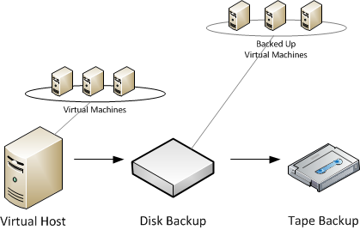
Battle-Tested Procedure #4
Shift off tape restores,
but also shift off the tape restore mentality.

Slide 25
Battle-Tested Procedure #4
Shift off tape restores,
but also shift off the tape restore mentality.
Evolve your use case for data recovery.
  Some data inside a VM needs restoration.
  That data might be files and folders, or it might be application objects contained within a database.
  To get it, power on the VM from whatever disk files you’ve backed up.
  Then, recover the data to wherever it needs to go.
  Finally, power down the VM. Task complete.

Slide 26
Battle-Tested Procedure #5
Test your backups.
No, really.

Slide 27
Battle-Tested Procedure #5
Test your backups.
No, really.
When was the last time you really, actually, truly, honestly, verifiably tested your backups?
  This week?
  This month?
  This year?
  Ever?

Slide 28
Battle-Tested Procedure #5
Test your backups.
No, really.
When was the last time you really, actually, truly, honestly, verifiably tested your backups?
  This week?
  This month?
  This year?
  Ever?
Why aren’t you?

Slide 29
Battle-Tested Procedure #5
Test your backups.
No, really.
We don’t test the backups, because doing so is dumb.
  They a manual, time-consuming, soul-eating, non-value-added,
  mind-numbing, fingernails-across-chalkboard, kill-me-now-type activity.
  Until they break.

Slide 30
Battle-Tested Procedure #5
Test your backups.
No, really.
We don’t test the backups, because doing so is dumb.
  They a manual, time-consuming, soul-eating, non-value-added,
  mind-numbing, fingernails-across-chalkboard, kill-me-now-type activity.
  Until they break.
What you need is automation.
  Power on isolated views of backed up server disks.
  Perform checksum verifications of view data.
  Verify application functionality through automated jobs.
  Remove the view in preparation for the next verification.

Slide 31
Five Procedures. One Call to Action.
define
augment
monitor
evolve
verify
Demand more out of your backup solution.

Slide 32
Five Battle-Tested Practices to Avoid Data Loss
Greg Shields, MVP, vExpert
Notes:
20110215

Slide 33
Interactive Demo
Veeam Backup & Replication

Slide 34
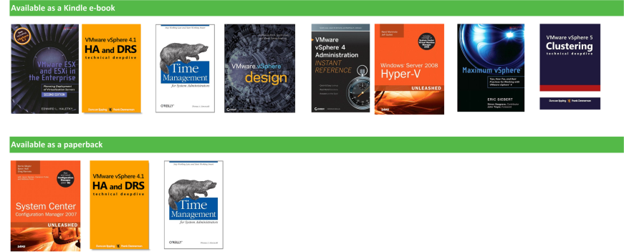
Questions and Answers
Winners receive a choice of the following books
Thank you for attending!
Resources:
  Twitter @Veeam Blog: http://www.veeam.com/blog Eval: Veeam.com

